Slide 1
A hitchhiker's Guide to Bayesian Statistics
Getting rid of p by using R

Slide 2
An overview
Where Fisher Went Wrong
Some More of Fisher’s Greatest Mistakes
Who is this Bayes Person Anyway, and what has he done with Fisher…
So Long and Thanks for the Null
The Answer to Life, The Universe, and Everything

Slide 3
Origins of the Debate:
Ronald Fisher
Thomas Bayes

Slide 4
Frequentist Perspective: Fisher’s Point of View
Central Question
Sampling Distribution
How likely is it that my observed sample observation x , with sample size n, came the population Ω with a true value of X?
Based on infinite draws of sample size n,
assuming the sampling distribution
Etc.,

Slide 5
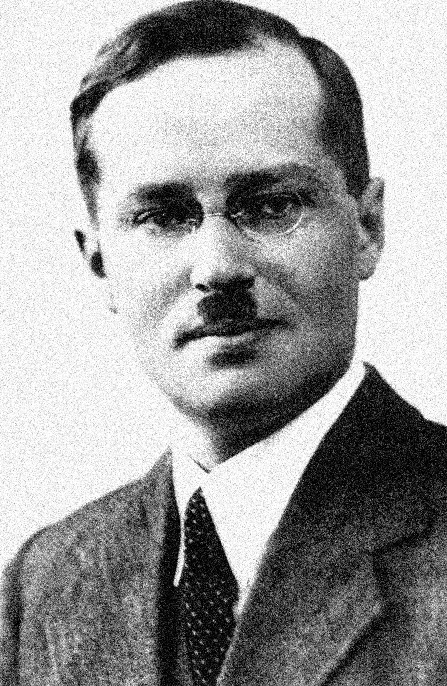
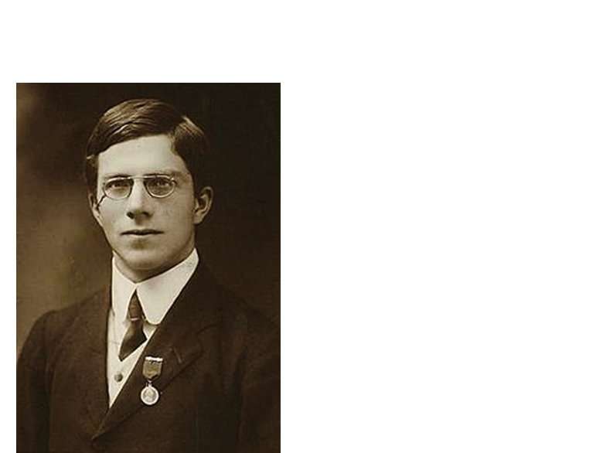
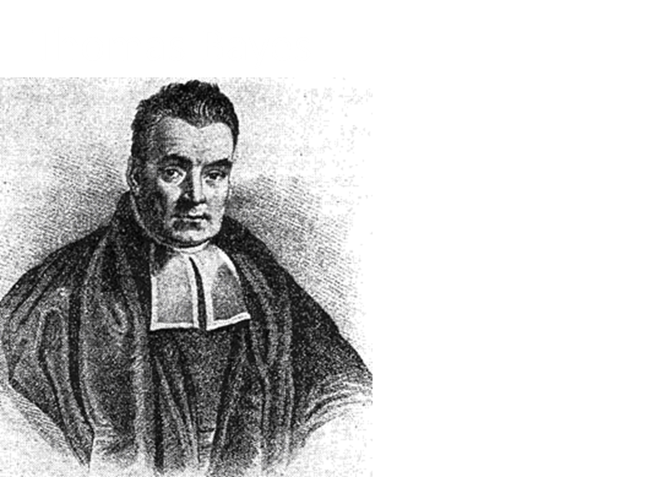
The Plot Thickens…
Jerzy Neyman
We should calculate confidence intervals!
Guys, I am not sure about that…..
SMH!
Yes! Then we can test a made-up hypothesis!!
Karl Pearson

Slide 6
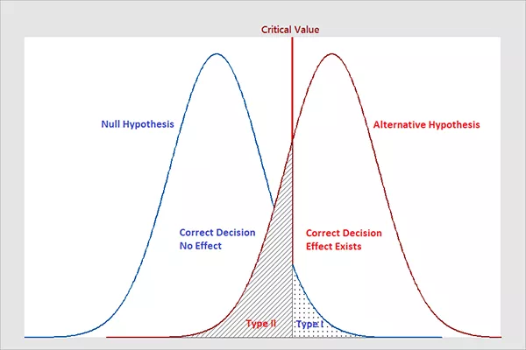
The p-value and the birth of NHST
But why me??
This is a myth

Slide 7
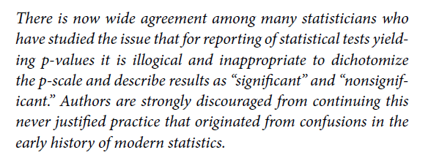
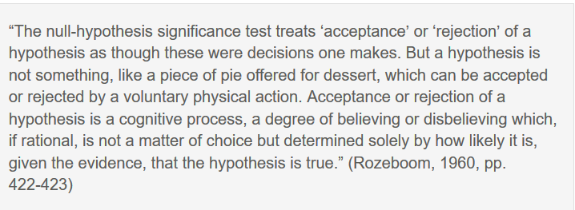
Let’s rethink this whole p-value thing….

Slide 8
Back to Bayes
A Different Question
Bayesian Inversion Formula
What is the likelihood of my model parameters, θ given that my data = D?
That is it really..
Consistent with inferential syllogism
If Model is TRUE, then data = D
Data = D
Therefore, Model is TRUE
But we cannot be certain data = D
Assess degree of certainty given what we know so far (knowledge is not independent)
“…we do not begin anew[with each new study]…previous research provides us with a priori information concerning the merit of the hypothesis” (Lynch, 2006)
Estimate Degree of Certainty:
$f\left(θ | data\right)=\frac{f\left(data | θ\right)f(θ)}{f(data)}$
Likelihood Function
Prior Probability
Marginal
Posterior Probability

Slide 9
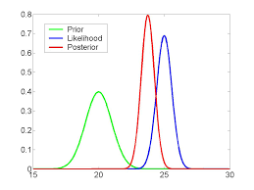
Bayesian Inference Model

Slide 10
Back to the Debate
My approach is much more consistent with the practice and philosophy of science; resolves all the problems with NHST
Ronald Fisher
Thomas Bayes
Yes, but I can calculate an answer and you can’t

Slide 11
So the world waits, and waits, and waits…..and waits…………………….and waits Until,

Slide 12
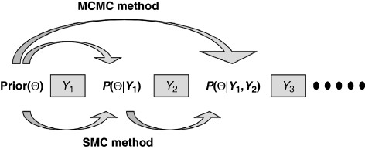
Markov Chain Monte Carlo

Slide 13
Implementing Bayesian Approaches in R
An empirical Example

Slide 14
Data: CAHC Evaluation – wave 1
Y = Number of Days of School Missed (1 = no days, 2 = 1-2 days, 3 = 3-5 days, 4 = 5+ days)
X1 = Stress at School (1 = no stress, 2 = a little stress, 3 = some stress, 4 = a lot of stress)
X2 = Poor Stress Coping (1 = positive stress coping, 5 = negative stress coping)
X3 = Physical Stress Symptoms (1 = no symptoms, 5 = constant physical symptoms)

Slide 15
Packages Used

Slide 16
The Data

Slide 17
Handling Missing Data

Slide 18
Data Summary

Slide 19
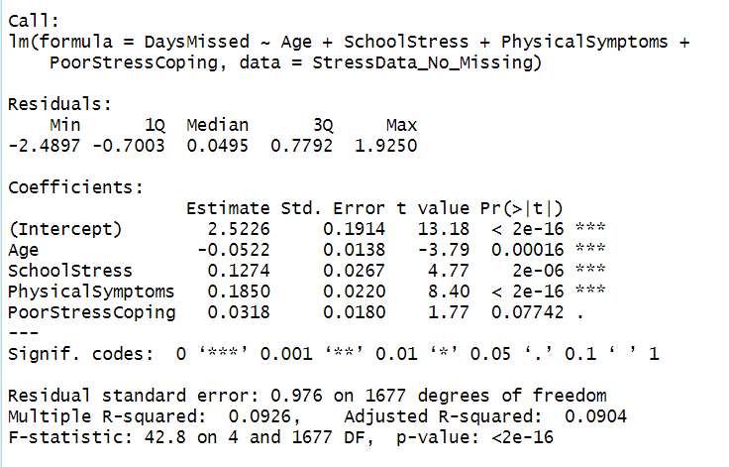
Traditional Frequentist Regression

Slide 20
Traditional Frequentist Regression

Slide 21
Saving Predicted and Residual Values

Slide 22
Regression Plots

Slide 23
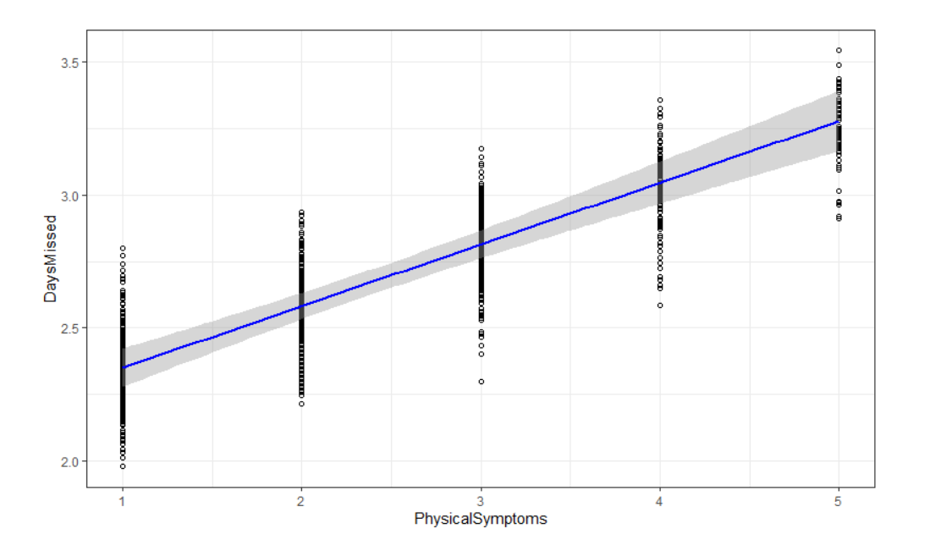

Slide 24
Bayesian Regression

Slide 25
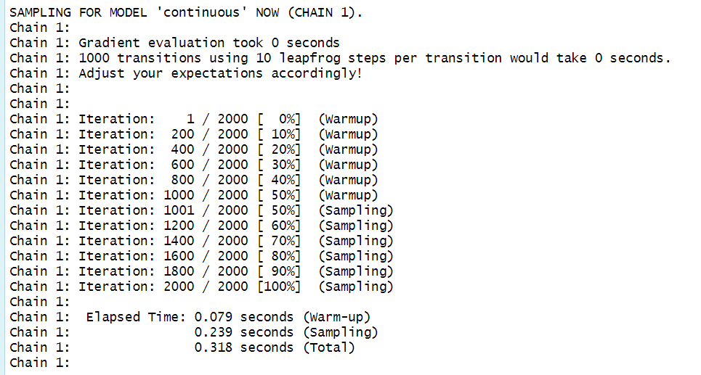

Slide 26
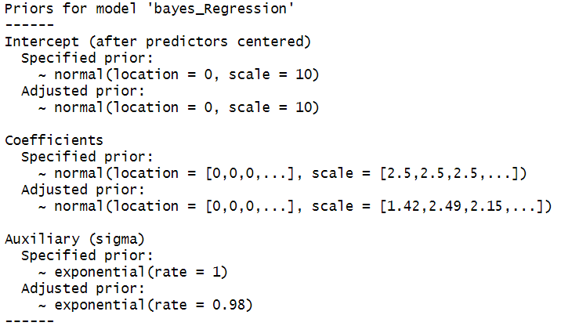

Slide 27
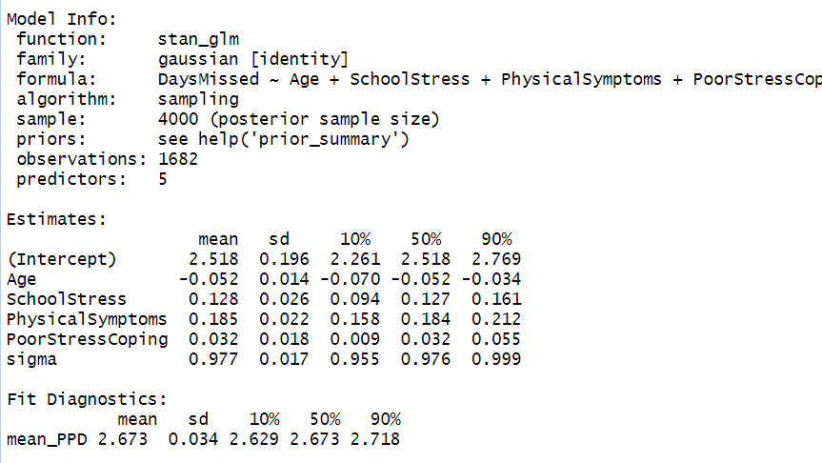
Matches the Sample Mean for Days Missed (y)

Slide 28
Rhat:
The split-R̂ statistic measures the ratio of the average variance of draws within each chain to the variance of the pooled draws across chains; if all chains are at equilibrium, these will be the same and R̂ will be one. If the chains have not converged to a common distribution, the R̂ statistic will be greater than one (see Gelman et al. 2013)
N_eff:
The effective sample size is an estimate of the number of independent draws from the posterior distribution of the estimand of interest. The n_eff metric used in Stan is based on the ability of the draws to estimate the true mean value of the parameter.

Slide 29
Comparison of Estimates

Slide 30
Evaluating the Bayesian Estimates
Confidence in what we know

Slide 31
Evaluating Trace Plots

Slide 32
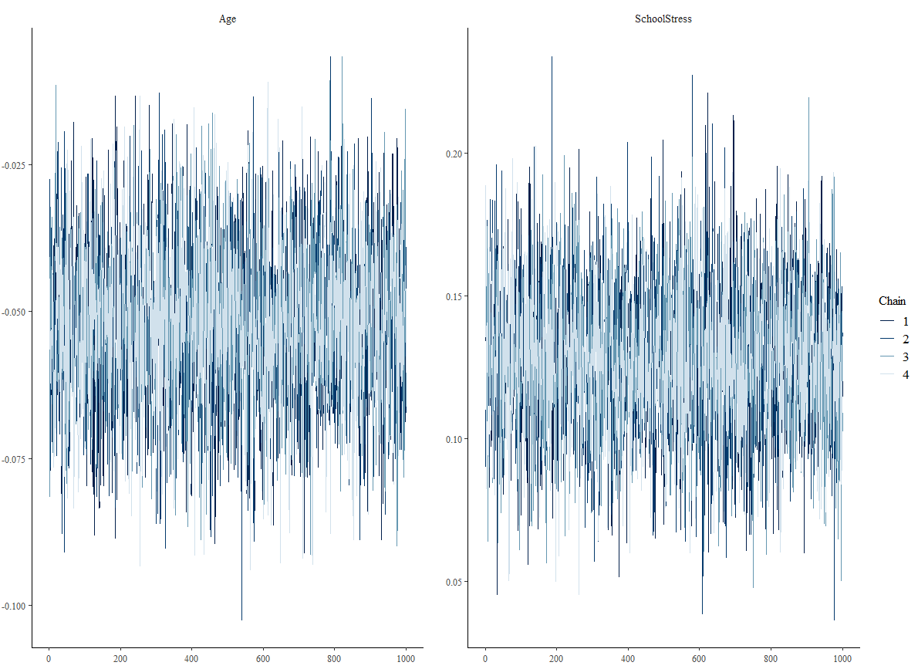

Slide 34
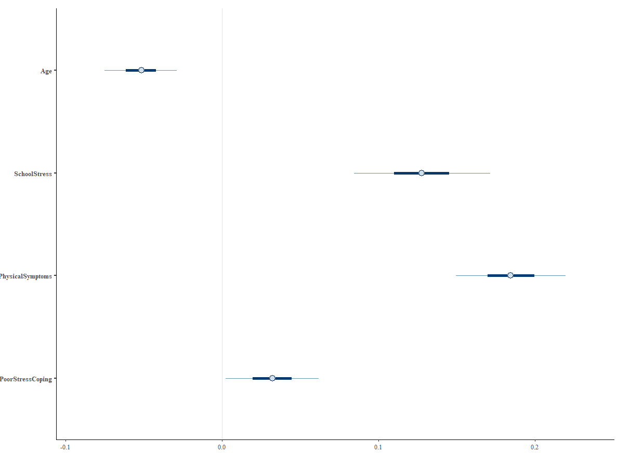

Slide 35
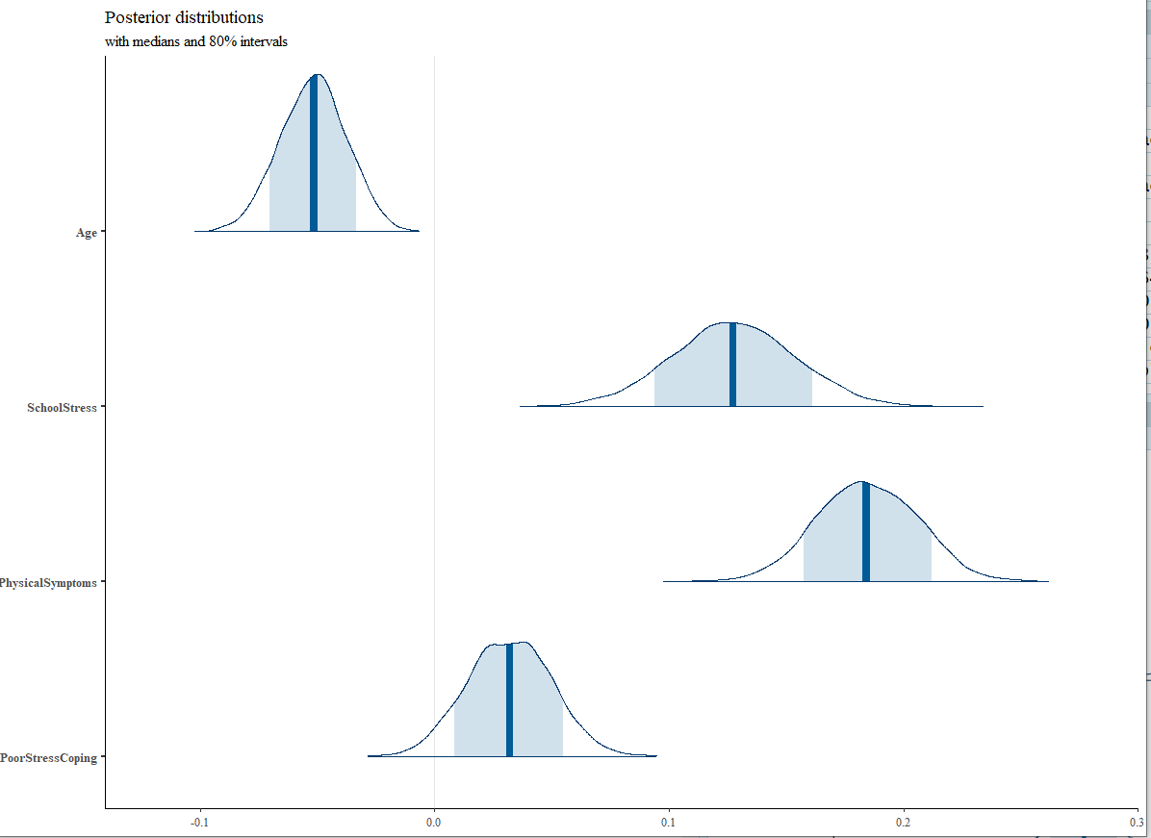

Slide 36
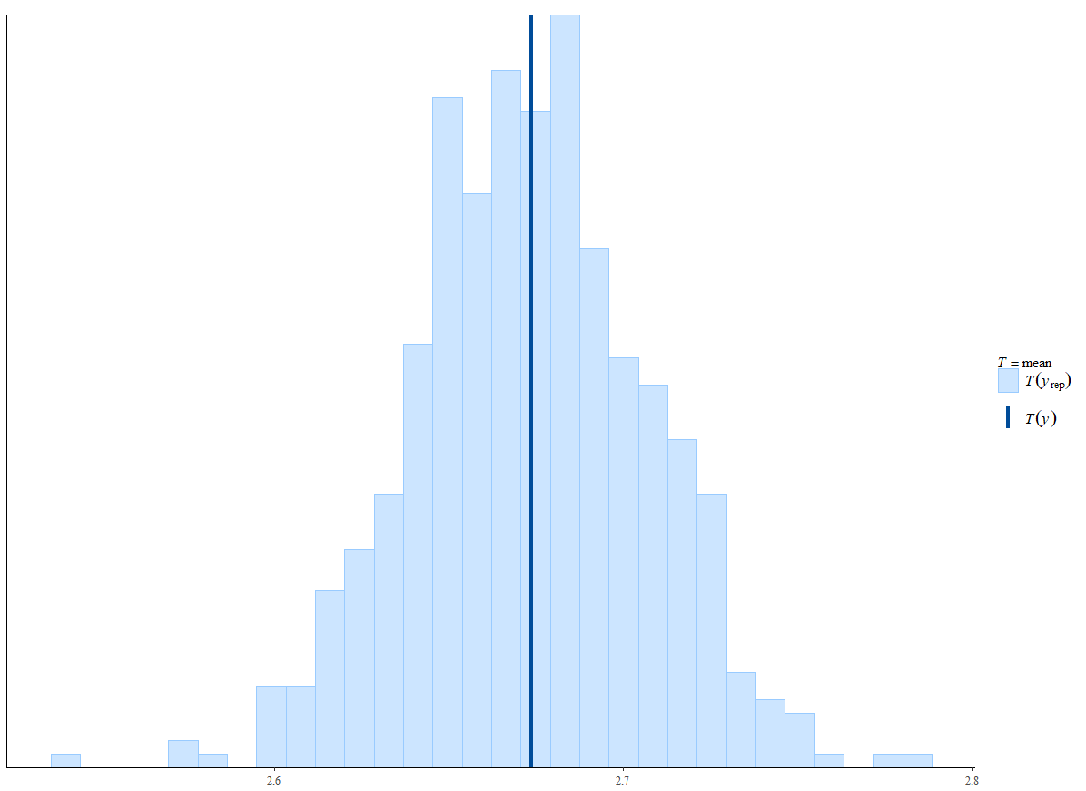

Slide 37
Plotting the Regression Line

Slide 38
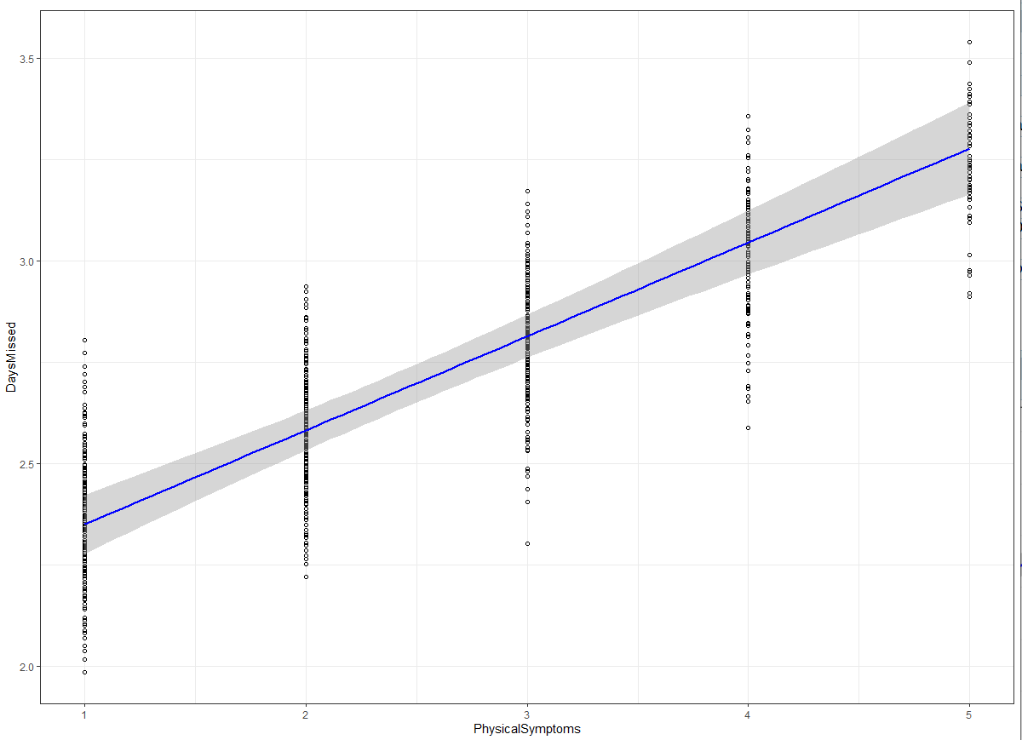

Slide 39
Model Fit Comparisons
Least Squares Regression
Bayesian Regression

Slide 40
Plotting Density Distribution and Correlation of Regression Estimates

Slide 42
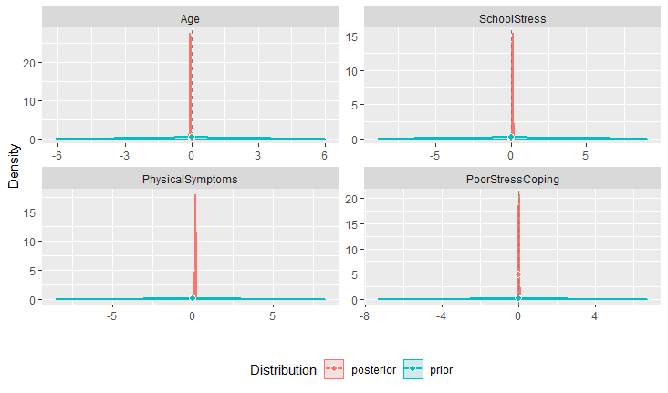

Slide 43
Testing against the null

Slide 44
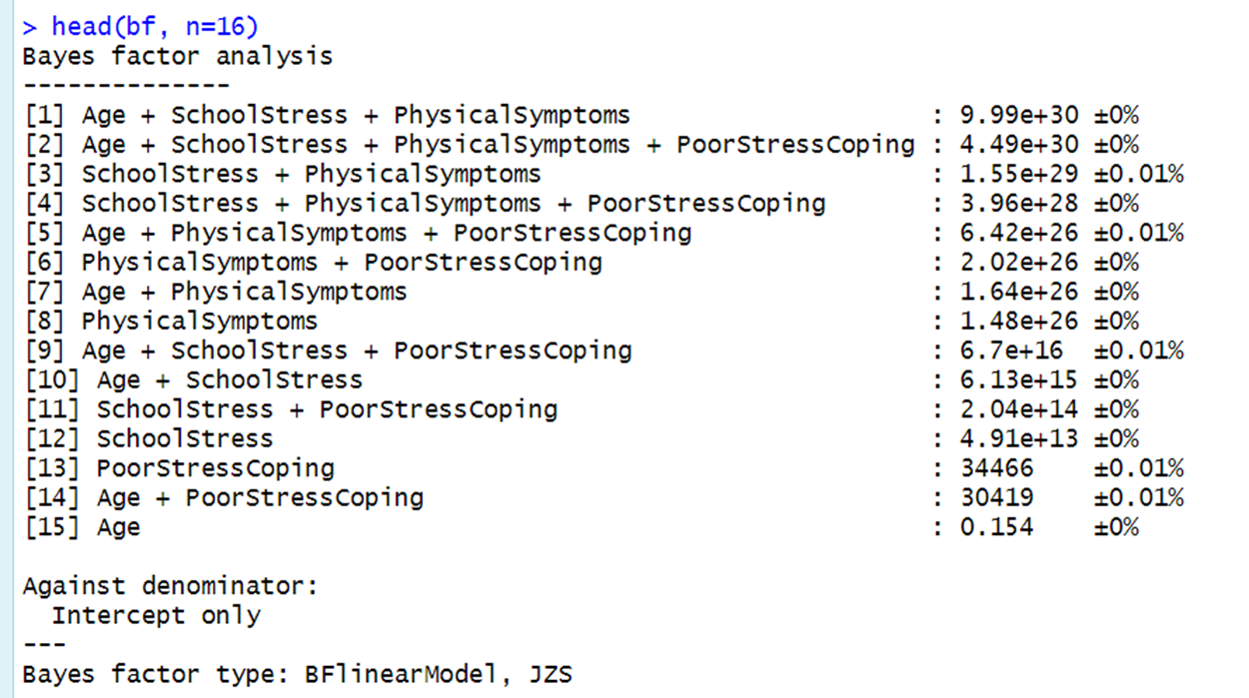

Slide 45
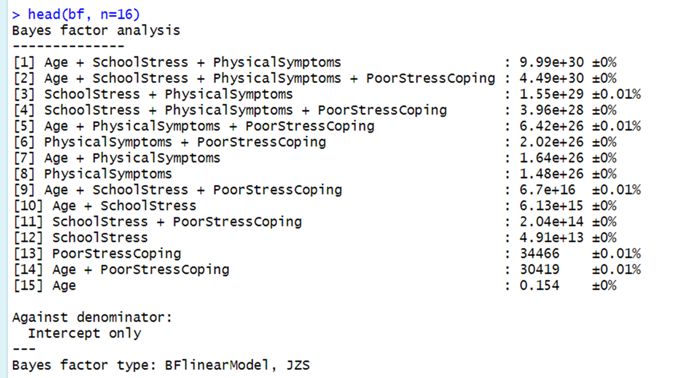
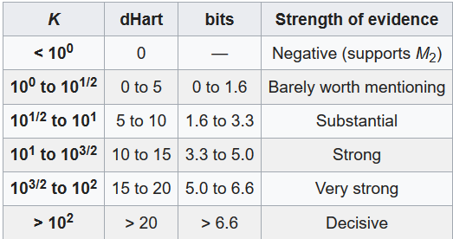
$$P\left(M | D\right)=\frac{P\left(D | M\right)p(M)}{P(D)}$$
$$K=\frac{{P(D|M}_{1}) }{{P(D|M}_{2})}=\frac{{\int{P(θ}}_{1}|M_{1}(P(D|θ_{1},M_{1 }){dθ}_{1}}{{\int{P(θ}}_{2}|M_{2}(P(D|θ_{2},M_{2 }){dθ}_{2}}= \frac{P\left(M_{1} | D\right)P(M_{2})}{P\left(M_{2} | D\right)P(M_{1})}$$
Negative Beta: log(1/k) =log(1/.154) = 3.11e+6
dHart = Log(K)
bit = 1/3(dHart)

Slide 46
Testing against Alt. Models

Slide 47
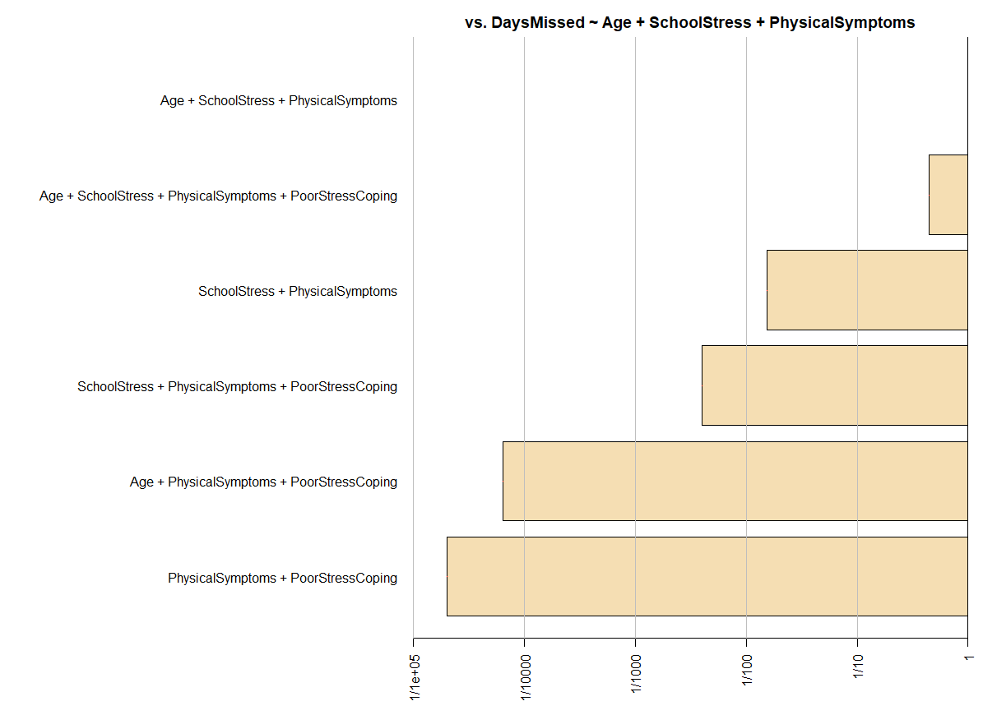

Slide 48
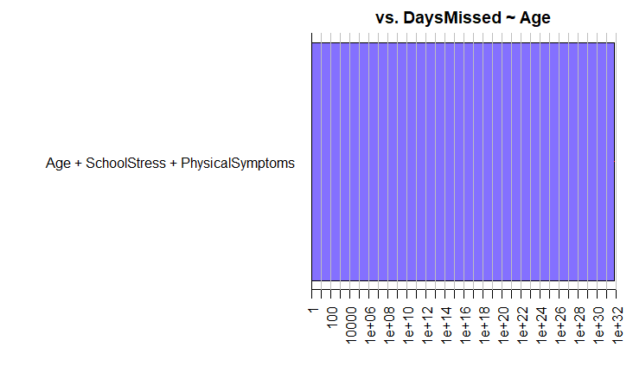
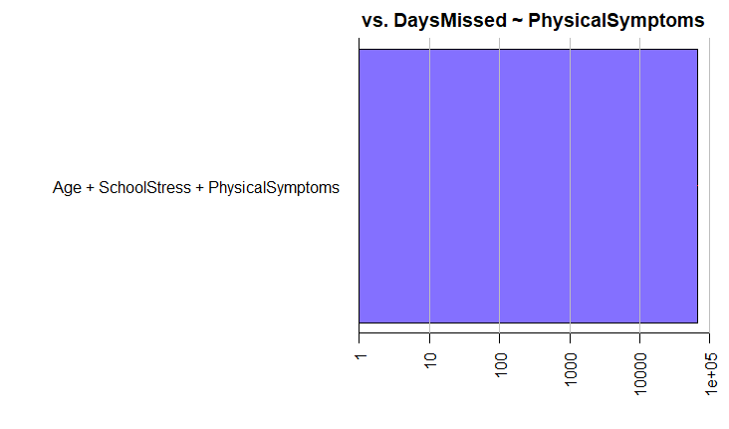
Testing Against specific models

Slide 49
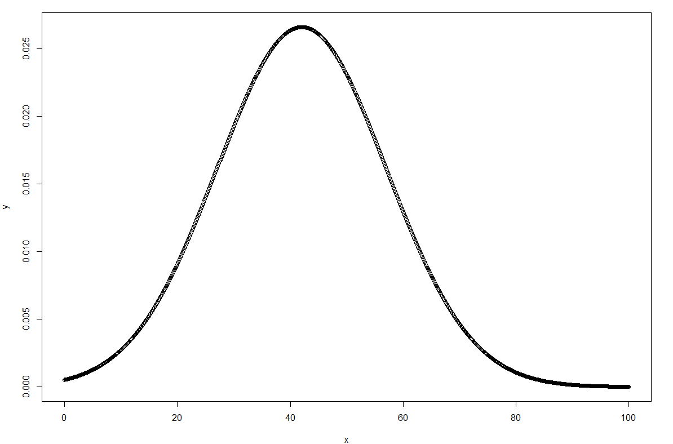
The Answer to the ultimate Question…
Answer <-stan.glm(Question ~ Life + The Universe + and Everything, data = ∞)
Summary(Answer)
[1] 42
Plot (Answer)
42

