Slide 1
Supporting Communities with Data: Empowerment Oriented Participatory Action Research

Slide 2
Without Data there is no problem

Slide 3
Without Data there is no problem
The story of five-points: Jacob Riis, photojournalism of 19th century immigrant life in New York

Slide 5
Without Data there is no problem
The story of five-points: Jacob Riis, photojournalism of 19th century immigrant life in New York
Documentary evidence from residential schools

Slide 6
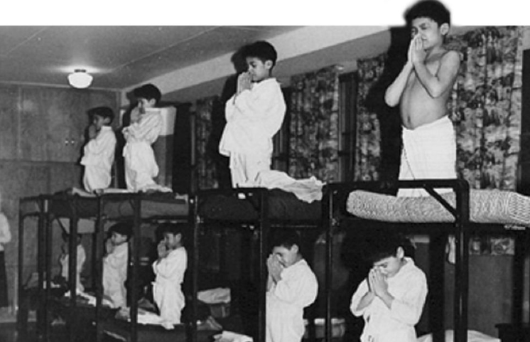

Slide 7
Without Data there is no problem
The story of five-points: Jacob Riis, photojournalism of 19th century immigrant life in New York
Documentary evidence from residential schools
Flint, MI lead poisoning from water supply

Slide 8
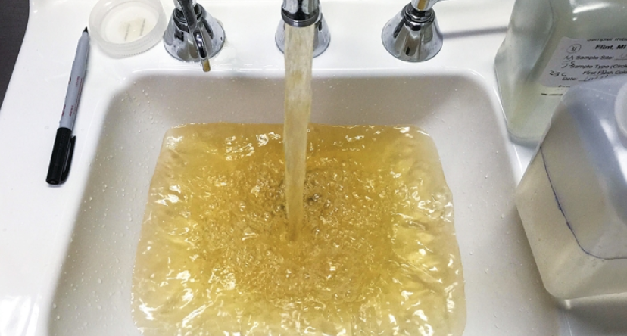

Slide 9
It is more than just data ~ the process matters

Slide 10
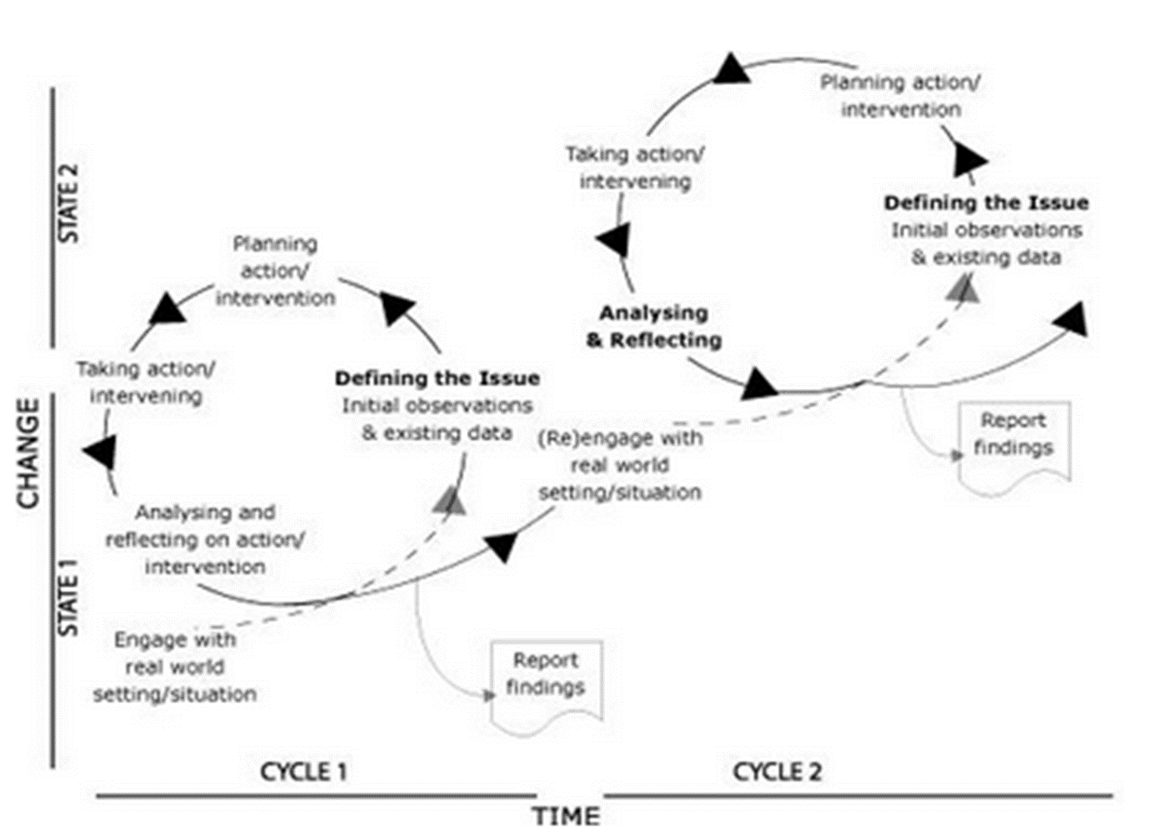
What Distinguishes Participatory Action Research “begin before the Beginning”

Slide 11
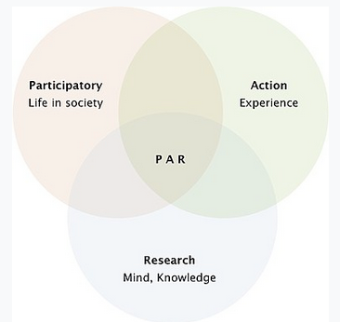
The Differences go deeper than Process
Ontological and Epistemological Approaches
Value Systems
Research Goals

Slide 12
Defining Principles
Foundations of Participatory Action Research

Slide 13
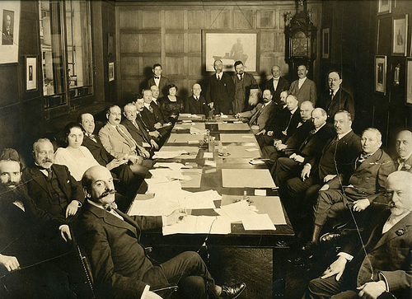
Framing, Analyses, and Solutions are embedded in Community Context

Slide 14
Transformational Social Change > h-Index

Slide 15
Egalitarian Participation
The research process involves all stakeholders
All voices are recognized as important

Slide 16
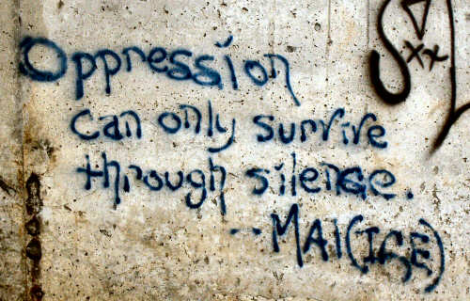
Explicit Recognition of Social Power Dynamics Inside and outside of the research process

Slide 17
Empowerment Solutions

Slide 18
Who has control of conceptual meanings
Gender is a made-up social construct that doesn’t exist
Gender is binary and rigid
Gender is a social construct that is a part of my identity, but I define it in a way that matches my lived experience

Slide 19
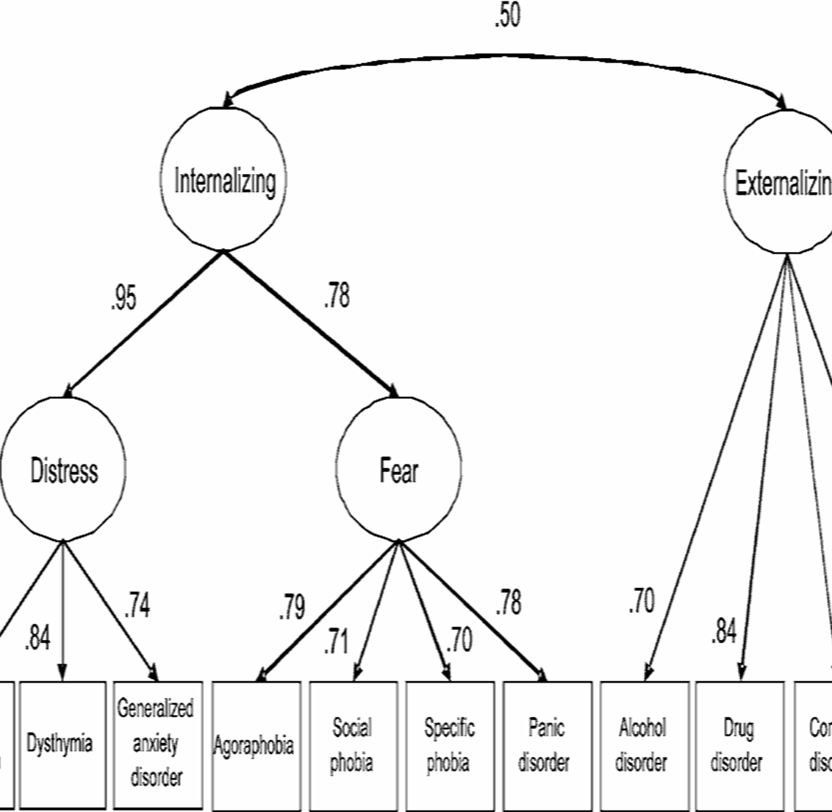
Medicalized Mental Illness
Self-determined socially embedded mental health

Slide 21
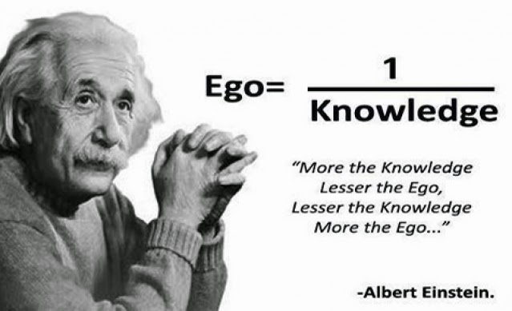
Where Does the Researcher Come in?
Leave Your Professional Preciousness at the Door
Reading about a thing….
Learning about a thing….
Not the same as living the thing.
Researcher is a co-participant in the research process, facilitating rather than driving.

Slide 22
That is very cool, but how would I do such a thing??

Slide 23
You must begin before the beginning
Engage with your community in ways that are meaningful to you, the research will follow.

Slide 24
The Bibs to Backpack Initiative
A Decade of Building Communities through Early Childhood Development

Slide 25
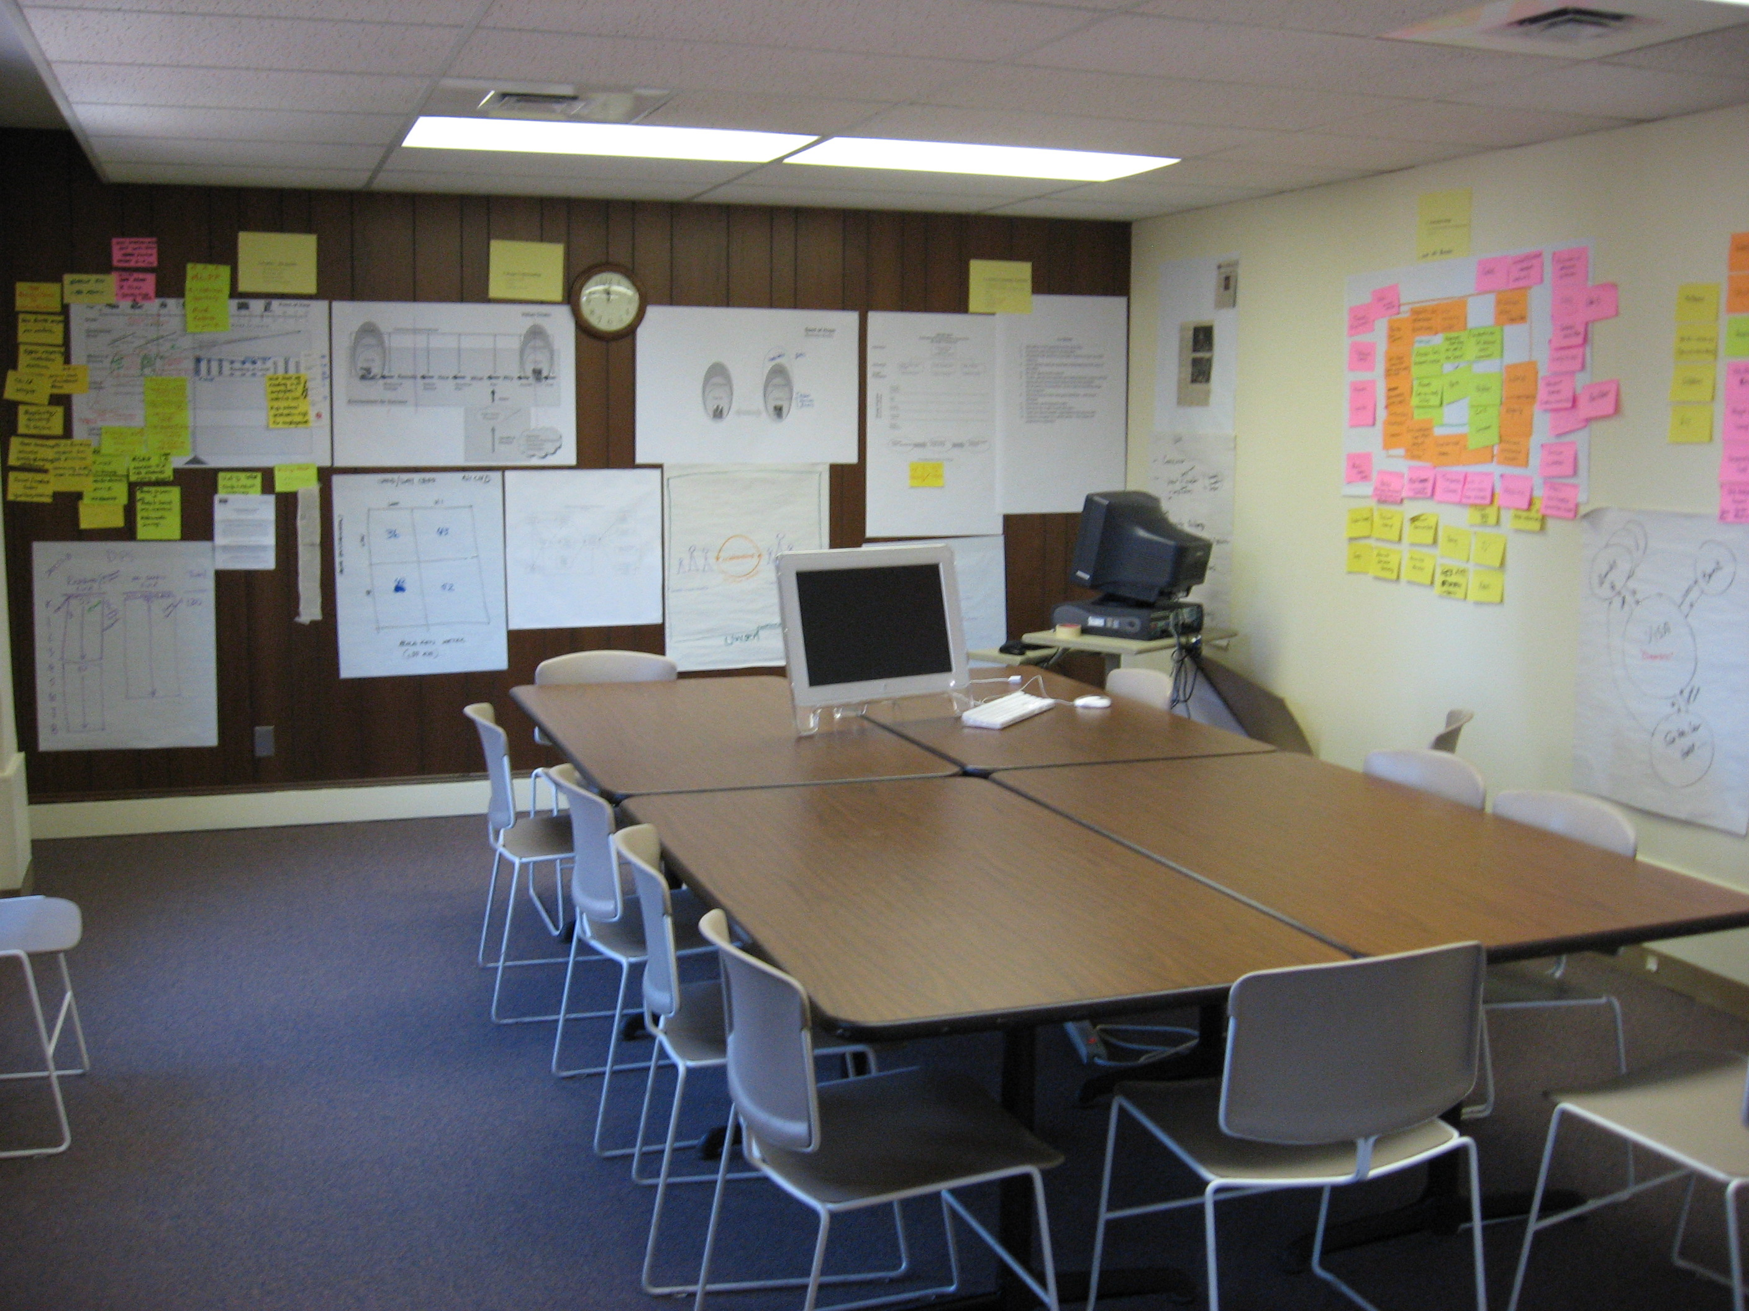

Slide 26
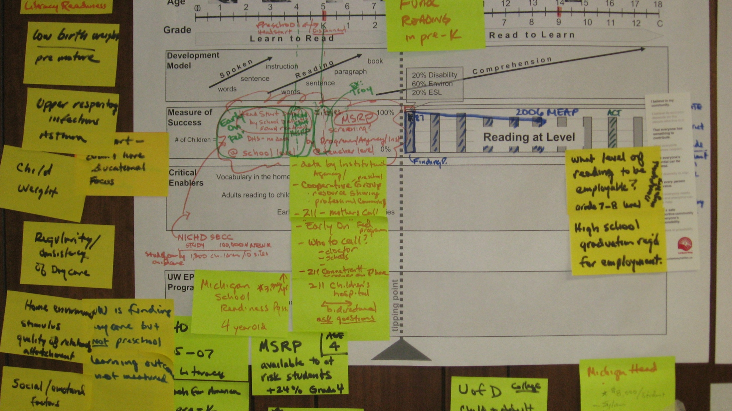
What is the educational Ecology of Metro-Detroit?

Slide 27
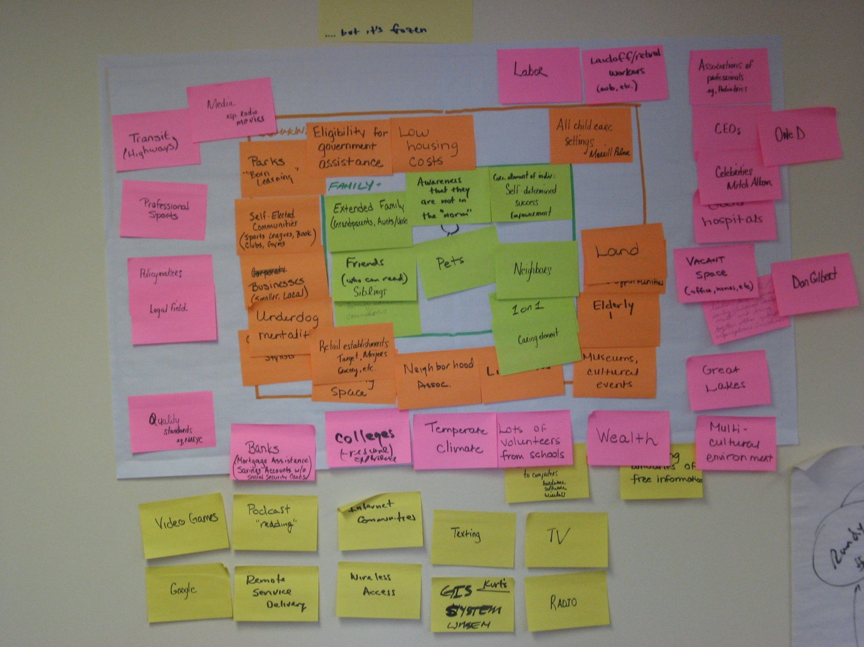
Critical Issue: Assets are Frozen
Individual Assets
Neighborhood Assets
Regional Assets
Technology Assets (Culture)

Slide 28
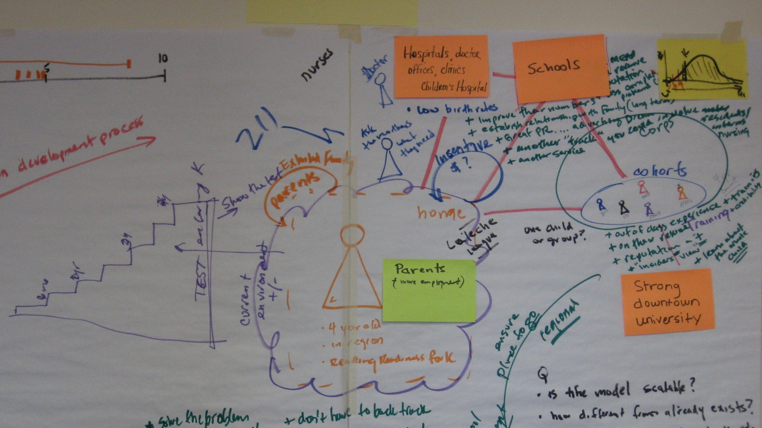
Our Ecological Impact Model: Creating Liquidity in Assets

Slide 29
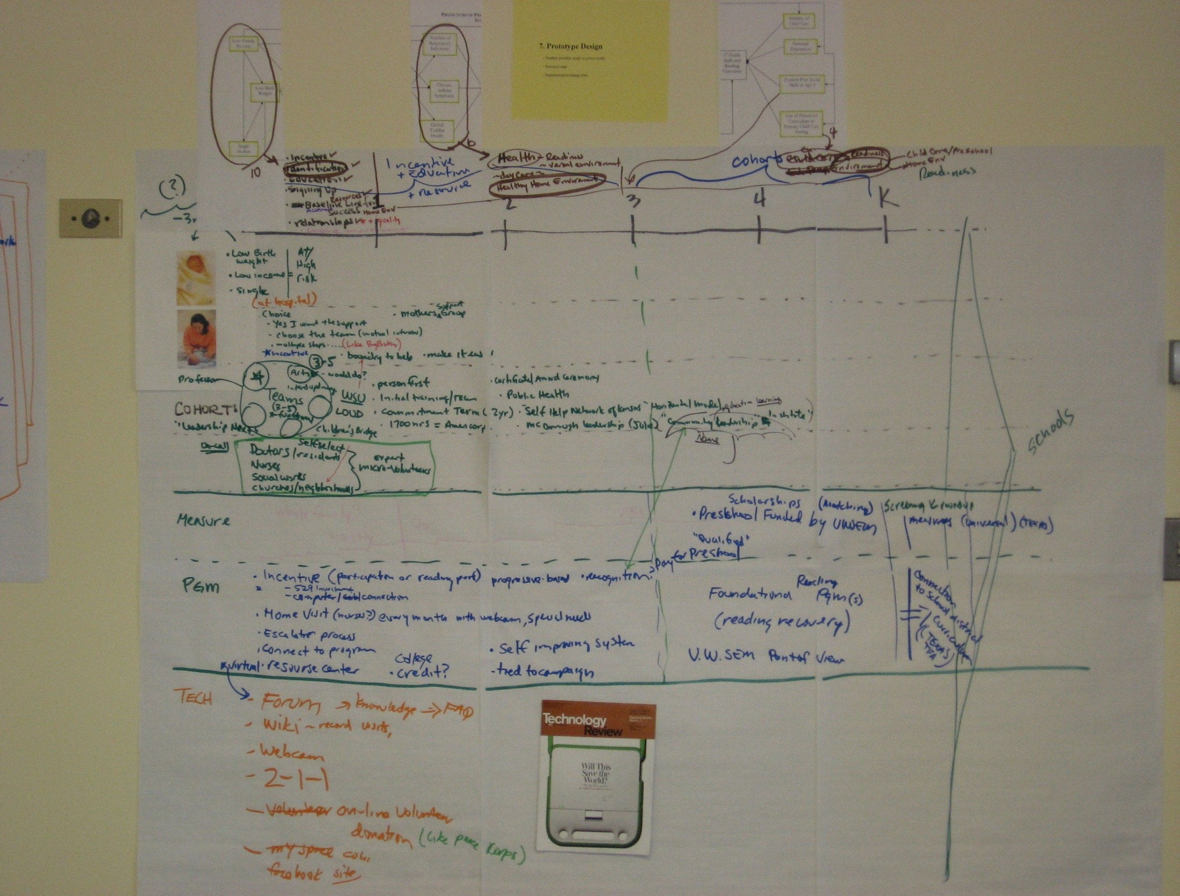
SECC Path Model
Phase III:
3-5 yrs
Preparing for School
Phase I:
0-12mo
Preparing the Family
Phase II:
2-3 yrs
Promoting healthy learning environment

Slide 30
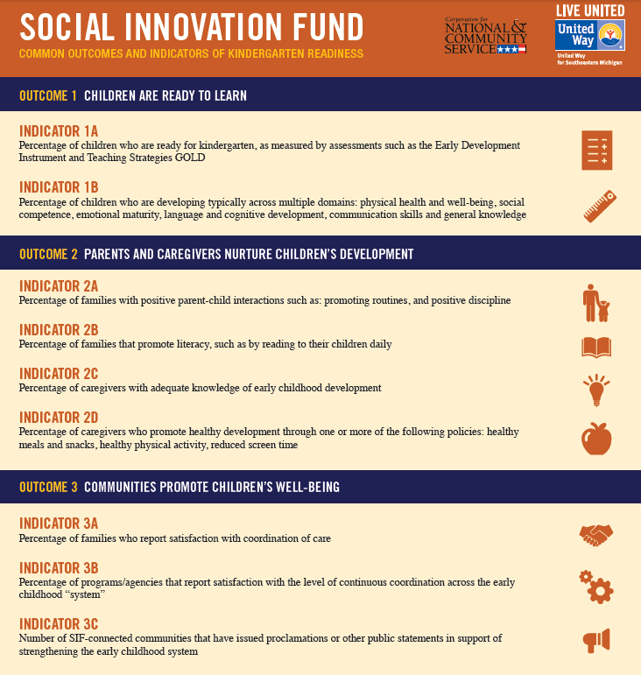
Social Innovation Fund 2011 - 2016

Slide 31
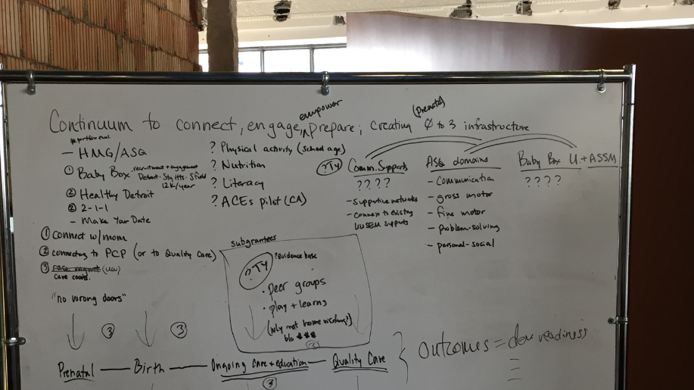
Back To the Drawing Board: SIF 2016-2020

Slide 32
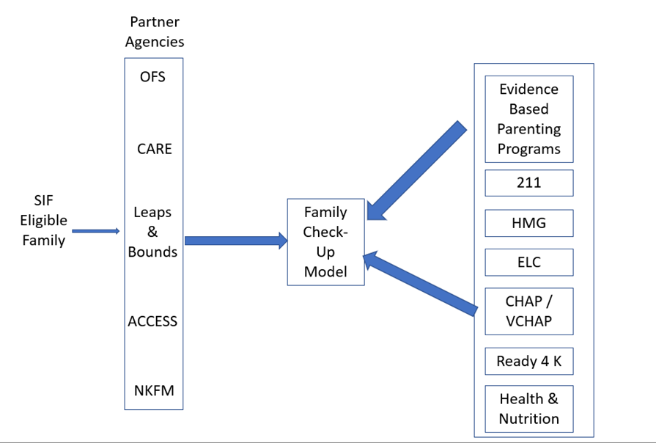
SIF 2016 BTB

Slide 33
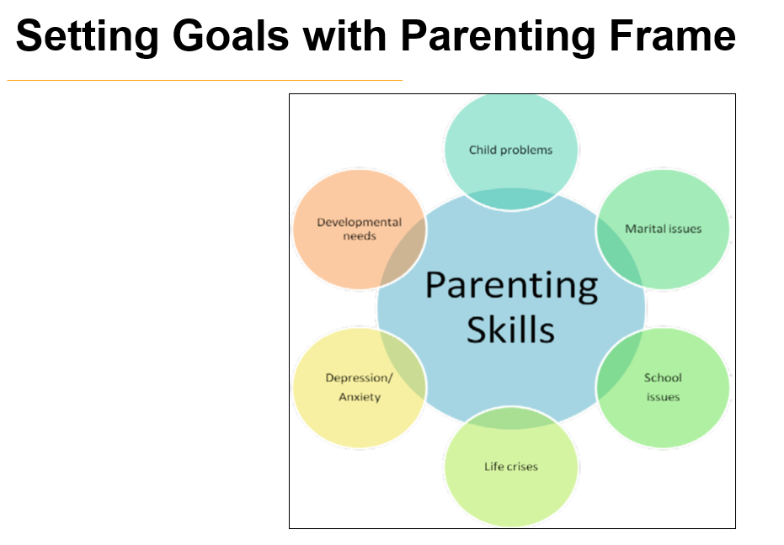
Collaborative Strengths Based Support

Slide 34
Starfish Blueprint Assessment Tool

Slide 35
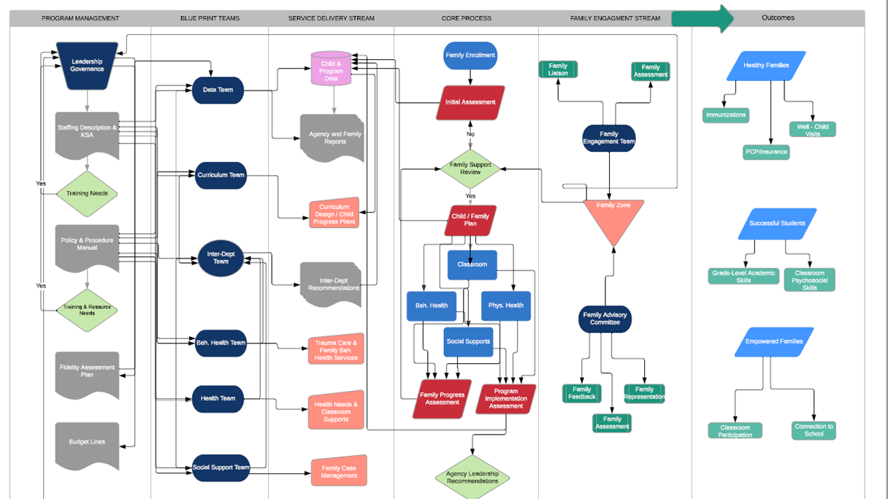
Implementation Model

Slide 36
Early Childhood Education Partnership Toolkit

Slide 37
How we got here

Slide 38
Blueprint Integration

Slide 39
Toolkit: Contents
Introduction – Overview, History and Intended Use
Five Universal Assessment Tools
Blueprint Alignment Assessment Tool
Red Flag Interpretation
Assessment Glossary

Slide 40
Assessment Domains
Collaboration/Partnership Assessment
Data Driven Organizational Assessment
Family Inclusion Assessment
Multi-Service Capacity Assessment
Communication Assessment
Alignment to Blueprint*

Slide 41
Collaboration / Partnership Assessment

Slide 42
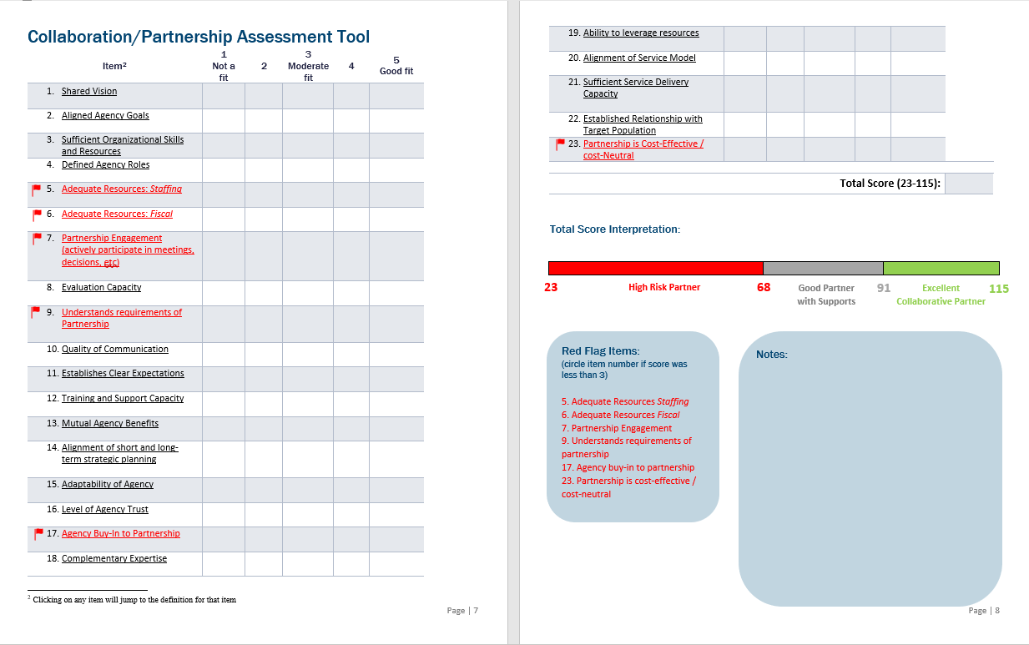

Slide 43
Data Driven Organizational Assessment

Slide 44
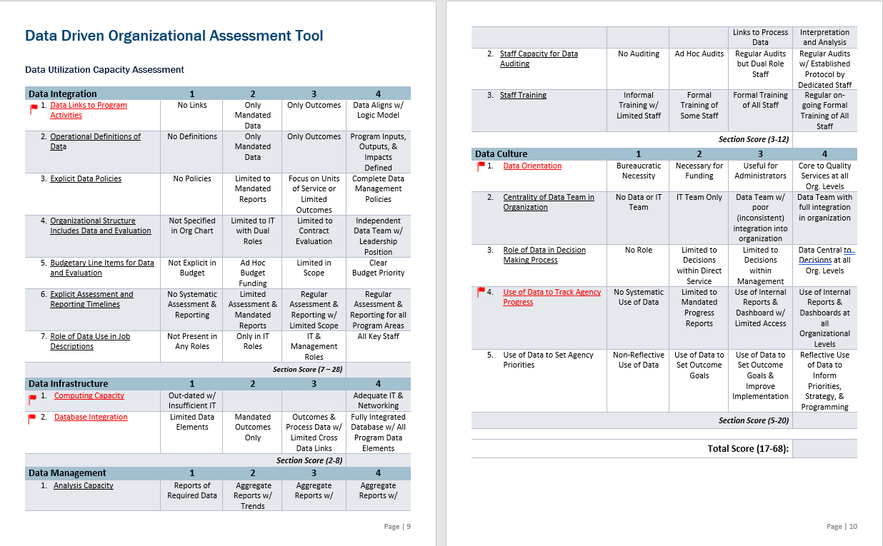

Slide 45
How is data being utilized in the organization?
Data User | Relevant Data
Classroom Teacher | Weekly Summary of Student Performance and Attendance
Family Support Worker | Weekly Summary of Student Classroom Assessments, Family Concerns, Attendance
Center Manager | Weekly Summary of Classroom Level Data on Attendance, Student Performance, Family Concerns
Director | Monthly Summary of Classroom Attendance, Teacher Assessments, Student Performance
Upper Administration | Quarterly Summary of Classroom Attendance, Classroom Performance, Teacher Assessments
CEO / Leadership Team | Quarterly Summary of Classroom Metrics, Center Metrics, Agency Metrics

Slide 46
How is data being incorporated into operations?
Data Level | Student / Family | Staff | Program | Agency | Data Validity Documented | Data Reliability Documented | Reporting Frequency
Classroom Teacher | Yes | No | Yes | No | Yes | Yes | Weekly
Family Service Worker | Yes | No | Yes | No | Yes | Yes | Weekly
Center Leader | Yes | Yes | Yes | No | Yes | Yes | Weekly
Director | No | Yes | Yes | Yes | Yes | Yes | Monthly
Upper Admin | No | No | Yes | Yes | Yes | Yes | Monthly
CEO/Leadership | No | No | Yes | Yes | Yes | Yes | Quarterly

Slide 47
Family Inclusion Assessment

Slide 48
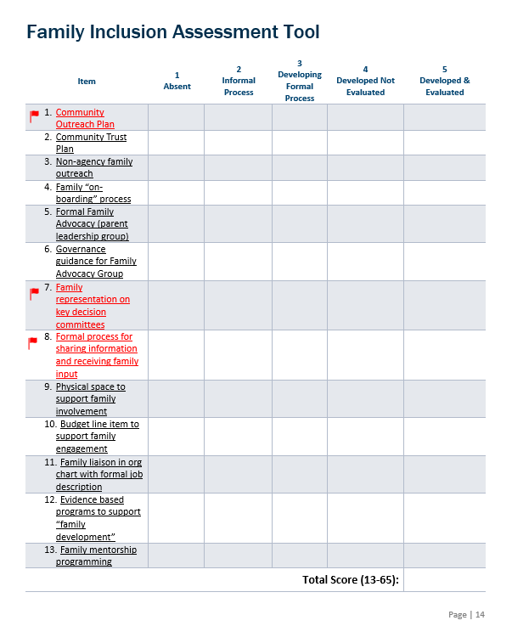

Slide 49
Multiservice Capacity Assessment

Slide 50
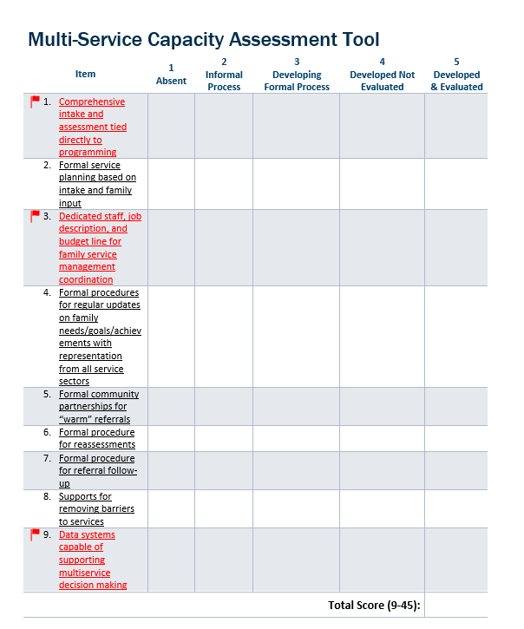

Slide 51
Communication Assessment

Slide 52
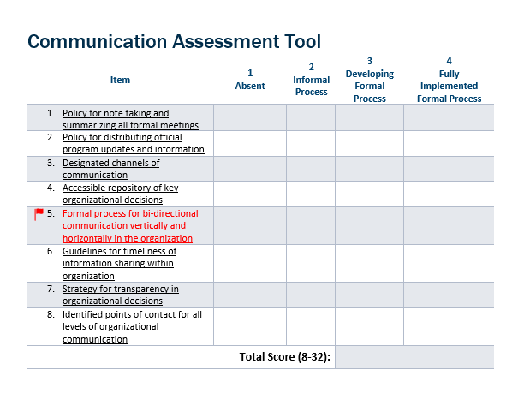

Slide 53
Blueprint Alignment

Slide 54
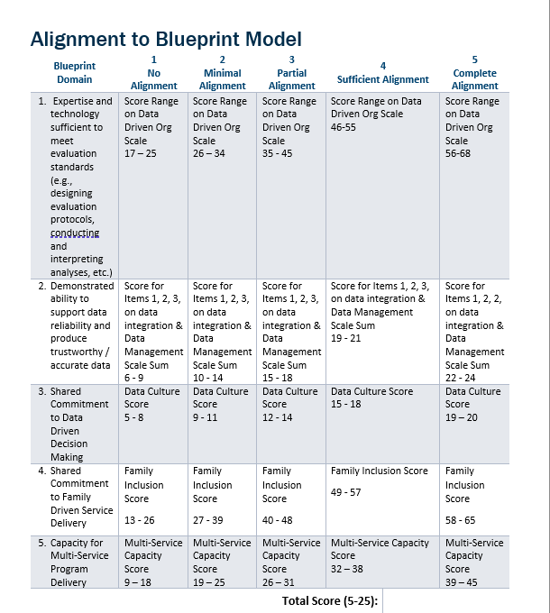
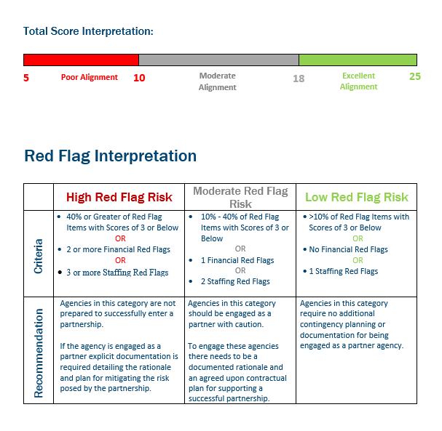

Slide 55
Purpose and Use
Guide creation of requests for qualifications (RFQ) and partnership proposal application requirements
Guide selection of potential partner agencies
Continuously monitor fidelity to the most essential features of many emerging Early Childhood Education (ECE) models
Tools can be used individually or in combination
Not specific to policies or practices, allows agencies to implement best practices that works within their agency culture and norm
Notes:
What is it
Applicable to many ECE service models
Why it’s the final deliverable of the project

Slide 56
Priority Gaps
Family Centric Approach
Organizational Infrastructure

Slide 57
Family Centric Approach
Defining Family Centric:
Family Input
Consideration of the entire family

Slide 58
Family Input:
Family Centric Approach
Defining an organizational family centric approach
Utilizing and valuing parent voice
Aligning screening processes to support a centralized intake process

Slide 59
Utilizing Family Voice
Family Advisory Committee (FAC)
Who is selected
How are they selected
Capturing Family Voice
Including meeting minutes in leadership discussions
Family representatives on leadership / decision making teams
Family surveys administered via FAC

Slide 60
How do we know: Family Engagement
Routine Assessment of Parent Engagement:
Parent opinion matters
Program changes in response to parent input
Parents feel like partners not consumers
Shared ownership of child outcomes
Existence of a Parent-Zone
Budget Supports for Parent Involvement
Parent Staff Liaison

Slide 61
EVALUATION OF THE IMPACT OF FOUR NEWLY STATE-FUNDED CHILD AND ADOLESCENT HEALTH CENTERS IN MICHIGAN

Slide 62
Evaluation Overview
In the spring of 2015, the Michigan Department of Health and Human Services commissioned an evaluation of the impact of four newly opened and state-funded school-based CAHCs on students’ health, well-being and educational success.
The evaluation investigated the CAHCs’ impact over a two-year school period in areas of priority to the CAHC Program at MDHHS, including indicators of:
physical and mental health
experience of stress and coping strategies
health literacy
access to and use of health care
educational behaviors and success

Slide 63
Community Feedback
“It will be interesting to see how students use the mental health service – there are some families who don’t want their kids talking to someone…some of it’s cultural, some of it’s for fear of getting in trouble for whatever is going on at home – some don’t want anybody to air their dirty laundry …. I think though that many of our students are finding that it’s a safe place, that they feel comfortable b/c it’s in a school. The kids are getting the parents to come in to let them receive services or to get financial help as well…”
Member of the Community Advisory Council
“Anger issues are big – feelings of powerlessness come across. A lot of it is home things – nobody listens to them. I hear the same things often – mom’s already on her phone; nobody is listening – anger episodes are going to come out more as they try to get some of that attention.”
CAHC health care provider
“(The CAHC) doesn’t feel like a health center– it’s comfortable. I like how the walls aren’t white like an insane asylum. They’re brown, warm…we’ve also got the mural… they’ve got kids pictures up there – it’s awesome.”
Student respondent
“Handling on our own creates more stress – we put so much pressure on ourselves – it builds up, keeps going – we’re always having it, not sharing it, not worrying others.” Student
“It’s not like you’re trying to be a teacher’s pet or whatever. You know, you just need somebody to talk to sometimes and I feel like if teachers always say you can come talk to me, they would not come talk to you. They were just like you blowing me off. Some teachers they like to be sarcastic and I just really don’t like that. Hate that. Trying to make jokes when you’re trying to be serious? Yeah. If you’re frustrated and the teachers might take it as you going off on them or you giving them a nasty attitude or it’s nothing like that. I need help, like help me understand. Right, it’s a frustration, not an anger type of thing? Yeah, and then they send you to the principal’s office.”
Student member of the Youth Advisory Council

Slide 64
Getting the Message to the Policy Makers
Resulted in $5,000,000 in State Budget for Increased Mental Health Services via SBHS

Slide 65
The Power of Stories to Raise Awareness

Slide 66
Questions

