Slide 1
All the questions you ever wanted to ask, but did not have the data to answer
Using Secondary Data Sources in Social Science Research

Slide 2

Secondary Data: What is it good for?
Longitudinal Research Questions
Especially Lifespan and multi-generation Studies
Biopsychosocial & Contextual Models
High dimensional developmental studies
Integrating Broad Science and Narrow Science
A different kind of mixed-method
Rigorous Theory Testing
Within-study replications

Slide 3
Longitudinal Research Questions
Early childhood Events & Adolescent / early Adulthood Outcomes
  NICHD Study of Early Child Care

Slide 4
NICHD-SECC
n≈ 1300, 158 datasets: analytic datasets, raw data, and supplemental files
Sample:
  Followed conditionally random sampling plan,
  included mothers who planned to work or to go to school full-time (60 percent) or part-time (20 percent) in the child's first year, as well as some who planned to stay at home with the child (20 percent),
  reflected the demographic diversity (economic, educational, and ethnic) of the sites.
  Both two-parent and single-parent families were included.
  exclusionary criteria:
  mothers younger than 18 years of age at the time of the child's birth,
  families who did not anticipate remaining in the catchment area for at least 3 years,
  Children with obvious disabilities at birth or who remained in the hospital more than 7 days postpartum,
  mothers not sufficiently conversant in English.
Assessment Periods
1mo | 6mo | 15mo | 24mo | 36mo | 48mo | 54mo | 60mo | 6yrs | 7yrs | 8yrs | 9yrs | 10yrs | 11yrs | 13.5yrs | 14.5yrs | 16yrs
Wave 1
Wave 2
Wave 3
Wave 4

Slide 5



Biopsychosocial & Contextual Models
Transdisciplinary Research Questions
  e.g. Cells to Society
Development IN Context Questions
  Adolescent Health Study (Add Health)

Slide 6
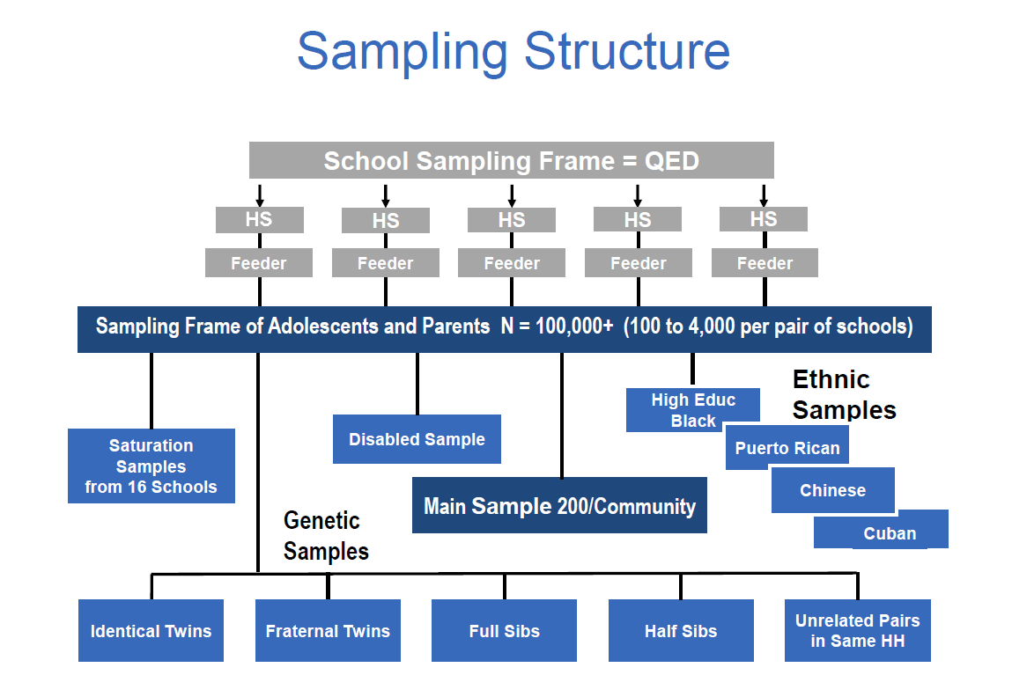
Add Health Sample

Slide 7
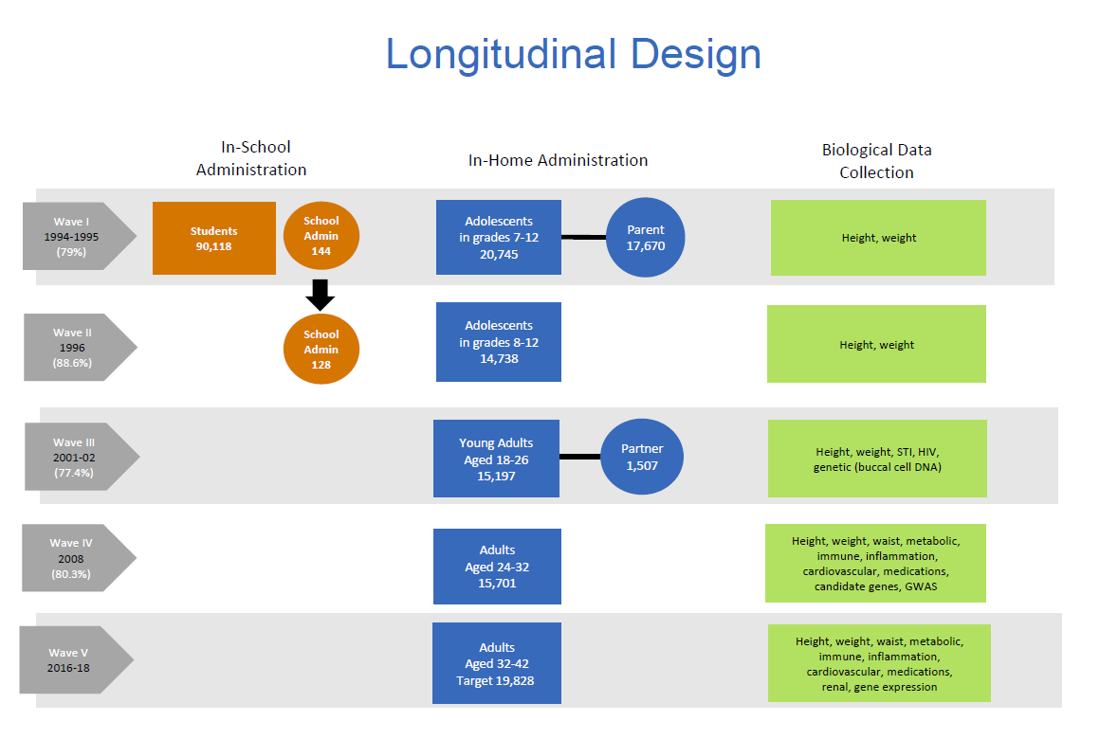
Add Health Design

Slide 8
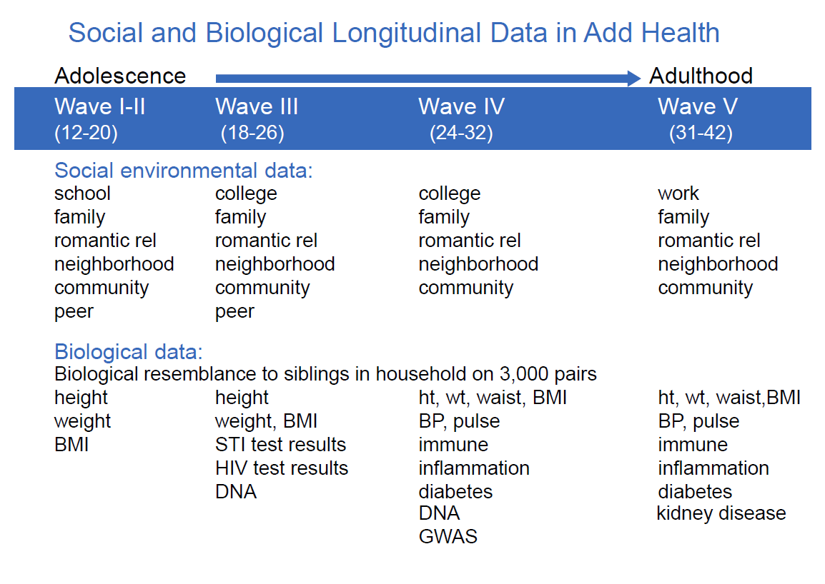
Add Health Variable Sets

Slide 9
Partridge, T. (2000). Familial and social stress, pubertal timing, and adolescent smoking: an epigenetic approach.
Late Peer Stressors
Early Peer Stressors
Time1 pubertal status
Hazard rate for onset of smoking
Time 2 pubertal status
Early Familial Stress
Late Familial Stress

Slide 10
Integrating Broad Science and Narrow Science
Balance of Breadth and Depth
Trade-off between large data sets with broad sets of measures and targeted studies designed to answer narrow questions
Overarching Context
Large Archival data set can answer big questions
Nuanced Findings
Inform individual studies to drill down into more nuanced questions.

Slide 11
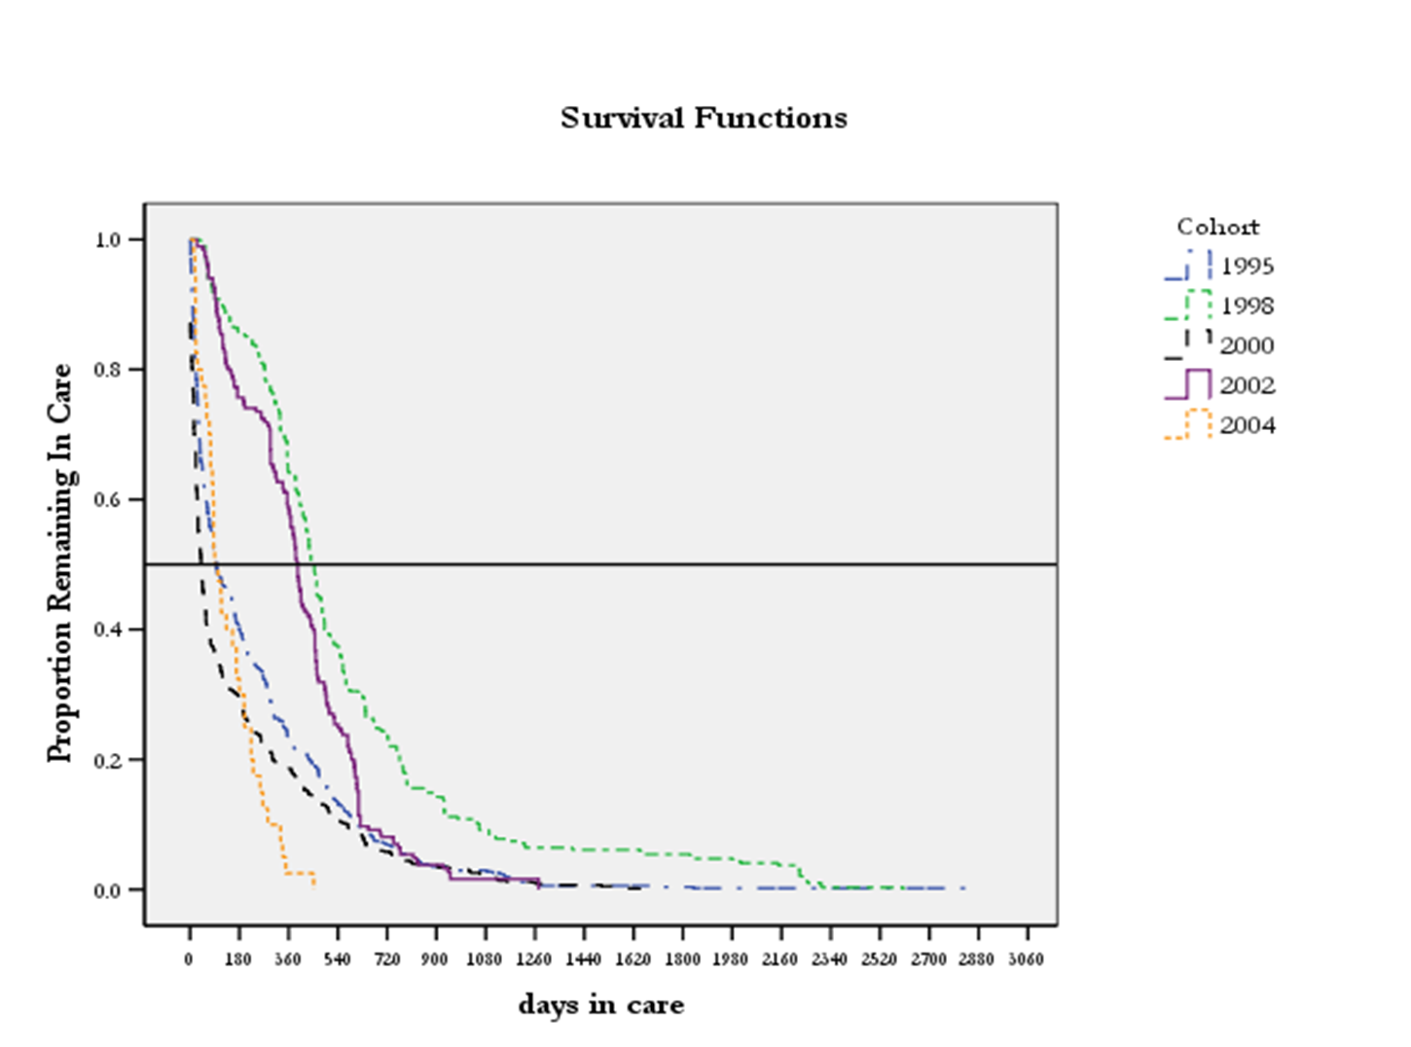
Findings from Michigan Foster Care Policy Study

Slide 12
Impact of Michigan foster care policy on child outcomes
National Survey of Child and Adolescent Well-Being (NSCAW)
  Part of the National Data Archive on Child Abuse and Neglect (NDACAN)
  n≈5,500 children aged (0-14yrs), 5 waves of data collection
  Assessment Domains:
  Cognitive, School Achievement, Language & Communication, Mental Health, Vinland Adaptive Skills, Socioemotional Development, Maltreatment, Child home and peer environment, school environment, Neighborhood factors

Slide 13
Stacks & Partridge, 2011
JIMH: INFANTS PLACED IN FOSTER CARE PRIOR TO THEIR
FIRST BIRTHDAY: DIFFERENCES IN KIN AND
NONKIN PLACEMENTS
What are the context Differences?

Slide 14
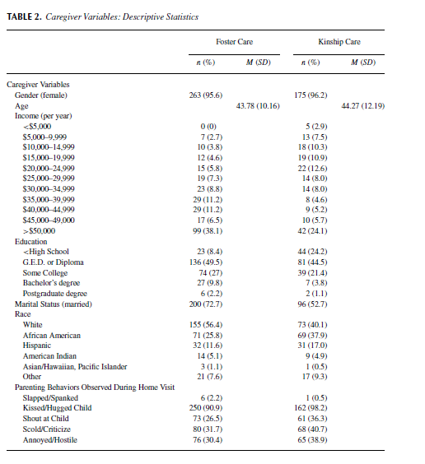
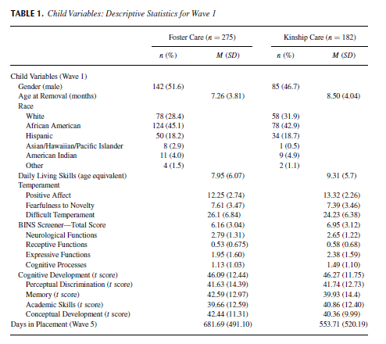
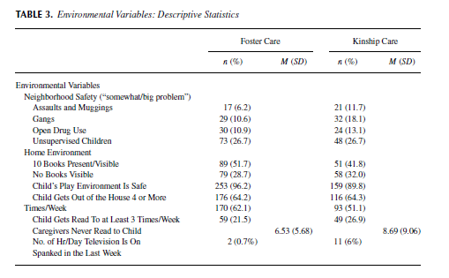
Differences in Child, Family,
& Neighborhood Context

Slide 15

Rigorous Theory Testing
Using archival data to replicate Models
  Etiology of Adolescent Substance Use

Slide 16
  Secondary Analysis of Substance Use Causal Processes
  NIDA:RO1 DA10306 (Brian R. Flay, PI), 1/97-11/01
Objectives:
to improve our understanding of the causal processes involved in becoming a user or abuser of alcohol
to improve upon methods of statistical analysis of longitudinal data in exploring causal processes.
Method:
conducted on seven existing longitudinal data sets,
each with four or more waves of data collected from youth between the ages of 10 and 25.
Test and replicate hypotheses regarding causal processes using the framework of an integrative theory of behavior onset and change developed by these investigators, the Theory of Triadic Influence (TTI).
Advantages:
enables replication of tests and contrasts of the most important of the existing theories
incorporates a wider range of predictor variables than any other single study
includes data from multiple ethnically and socioeconomically diverse samples
Allows for sophisticated analytical techniques to examine mediating, moderating and feedback relationships

Slide 17
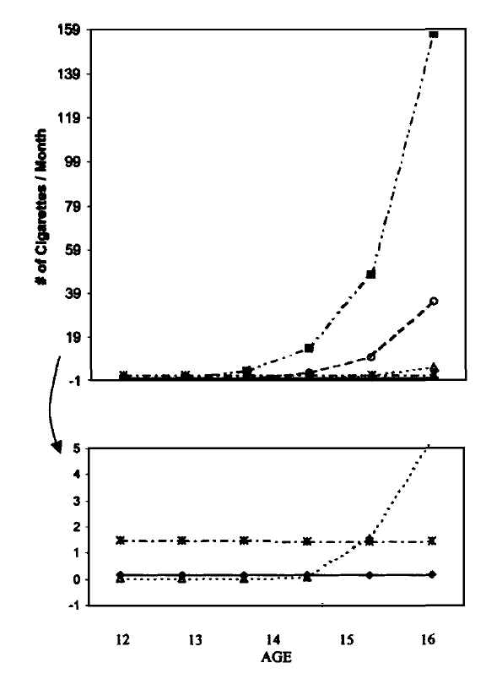
Colder et al., (2001) Health Psychology

Slide 18

That is very cool, but how would I do such a thing??

Slide 19
Repositories of Archival Data
ICPSR Inter-University Consortium for Political and Social Research
Murray Center
Carolina Population Institute
Traumatic Brain Injury National Data and Statistical Center

Slide 20

Considerations when using archival data

Slide 21

Lessons from experience:
AKA I am old and have broken lots of things
The data is already collected they said, This will be so fast they said…..
Know the answer before you ask the question
It is not your data (Do you know where your files are right now?)
Codebook Shmozebook
Follow the Rules (and there are lots of rules)

